Slide 1
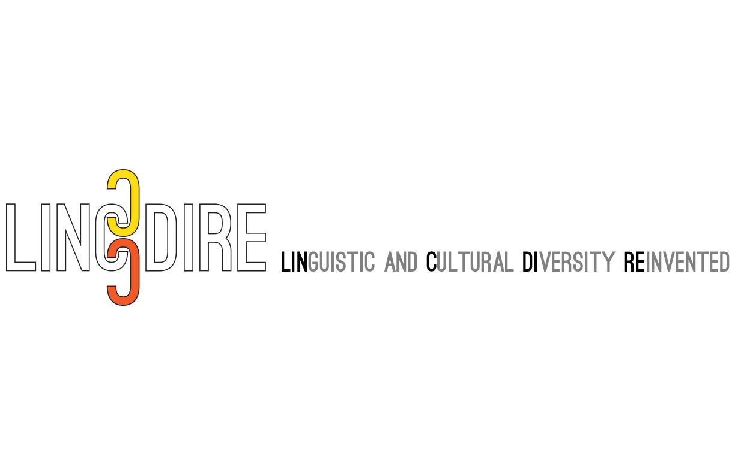
Plurilingualism, Action-Oriented Approach and Indigenous Epistemologies:
The Linguistic and Cultural Diversity Reinvented (LINCDIRE) Project
Enrica Piccardo (OISE/University of Toronto)
Aline Germain-Rutherford (University of Ottawa)
Alan Corbiere (M'Chigeeng First Nation)
Sara Potkonjak (York University)
Geoff Lawrence (York University) Kris Johnston (York University)
Discussant: Heather Lotherington (York University)
Association canadienne de linguistique appliqué/Canadian Association of Applied Linguistics - Congress May 31, 2017
Notes:
Active appreciation and preservation of North America’s linguistic and cultural diversity is needed to prevent linguistic loss and cultural homogenization. This paper explores the relevance and potential of Language Integration through E-portfolio (LITE), a digital environment which fuses western-plurilingual and Aboriginal pedagogical approaches to foster lifelong language and pluricultural learning. It reports on the design and piloting stages of LITE, offering practical considerations for teachers wishing to adapt the tool for local contexts.

Slide 2
Symposium Overview
Promoting plurilingualism in North America through a CEFR-inspired pedagogical online platform: LINCDIRE and LITE (Enrica Piccardo) The development of a pedagogical framework fusing Western and Indigenous approaches for plurilingual and pluricultural learning environments (Aline Germain-Rutherford & Alan Corbiere) Developing plurilingual, action-oriented tasks: Implications for pedagogy and teacher and student beliefs (Sara Potkonjak) Exploring the potential of technology to promote linguistic and cultural diversity: A plurilingual e-portfolio approach (Geoff Lawrence & Kris Johnston)
Opening remarks for discussion (Heather Lotherington)
Notes:
Linguistic and cultural diversity is inherent in North America, where both Canada and the U.S. are homes to multiple languages, including heritage, Aboriginal and official languages. This reality requires language teaching approaches that better reflect and enhance such diversity, and instill in teachers and learners a reenvisioned attitude towards language and cultural plurality (Cummins, 2007; Dyck & Kumar, 2012). This colloquium builds upon a large SSHRC-funded international research partnership which is developing a technology-enhanced, action-oriented approach that promotes plurilingualism (Piccardo, 2013) and examines its potential. With researchers and educators from Canadian, U.S., and French institutions, this project introduces a unique pedagogical model that includes plurilingualism and Indigenous pedagogies to actively draw on language learners’ existing “funds of knowledge” (Gonzalez, Moll & Amanti, 2006) in the development of strategic plurilingual competencies, fostering lifelong language and pluricultural learning. The first paper introduces the project’s scope and developmental stages, theoretical framework and contributing epistemologies, and the results of the piloting phrase. The second paper details the collaborative process of developing a unique pluricultural pedagogical framework that fuses Western and Indigenous approaches in education, embracing a “multiple cultures” model (Henderson, 1996; 2007) so minority languages and cultures are both considered and integrated in the learning environment (Germain-Rutherford, 2008). The third paper discusses the CEFR-inspired (Council of Europe, 2001) development of plurilingual/pluricultural action-oriented tasks and their pedagogical implications. The fourth paper presents the project’s online environment, including its medicine wheel informed e-portfolio tool and the LMS which integrates action-oriented, plurilingual tasks.

Slide 3
Symposium Overview
Promoting plurilingualism in North America through a CEFR-inspired pedagogical online platform: LINCDIRE and LITE (Enrica Piccardo) The development of a pedagogical framework fusing Western and Indigenous approaches for plurilingual and pluricultural learning environments (Aline Germain-Rutherford & Alan Corbiere) Developing plurilingual, action-oriented tasks: Implications for pedagogy and teacher and student beliefs (Sara Potkonjak) Exploring the potential of technology to promote linguistic and cultural diversity: A plurilingual e-portfolio approach (Geoff Lawrence & Kris Johnston)
Opening remarks for discussion (Heather Lotherington)
Notes:
Linguistic and cultural diversity is inherent in North America, where both Canada and the U.S. are homes to multiple languages, including heritage, Aboriginal and official languages. This reality requires language teaching approaches that better reflect and enhance such diversity, and instill in teachers and learners a reenvisioned attitude towards language and cultural plurality (Cummins, 2007; Dyck & Kumar, 2012). This colloquium builds upon a large SSHRC-funded international research partnership which is developing a technology-enhanced, action-oriented approach that promotes plurilingualism (Piccardo, 2013) and examines its potential. With researchers and educators from Canadian, U.S., and French institutions, this project introduces a unique pedagogical model that includes plurilingualism and Indigenous pedagogies to actively draw on language learners’ existing “funds of knowledge” (Gonzalez, Moll & Amanti, 2006) in the development of strategic plurilingual competencies, fostering lifelong language and pluricultural learning. The first paper introduces the project’s scope and developmental stages, theoretical framework and contributing epistemologies, and the results of the piloting phrase. The second paper details the collaborative process of developing a unique pluricultural pedagogical framework that fuses Western and Indigenous approaches in education, embracing a “multiple cultures” model (Henderson, 1996; 2007) so minority languages and cultures are both considered and integrated in the learning environment (Germain-Rutherford, 2008). The third paper discusses the CEFR-inspired (Council of Europe, 2001) development of plurilingual/pluricultural action-oriented tasks and their pedagogical implications. The fourth paper presents the project’s online environment, including its medicine wheel informed e-portfolio tool and the LMS which integrates action-oriented, plurilingual tasks.

Slide 4
Background
Around 7 million Canadians speak a non-official language (Statistics Canada, 2012)
65+ aboriginal languages and several heritage languages (Census Canada, 2012)
Site for Language Management in Canada (SLMC)
60 million Americans speak a language other than English (382 different languages with 134 native languages) (US census Bureau, 2015)
Lack of recognition of non-dominant languages in mainstream education (Wiley & Lukes, 1996; Hornberger, 2001).
Schools are not prepared to take advantage of linguistic diversity > decline of home languages (Cantoni, 1997; Crawford, 2000). and inequities in education
Notes:
Canada and the US are home to a linguistically diverse population. Almost 6.6 million Canadians speak a language other than English and French at home (Statistics Canada, 2012).
In addition to the 2 official languages, approximately 65 Aboriginal languages and a multitude of heritage languages are spoken in Canada.
https://slmc.uottawa.ca/?q=native_peoples_languages
Site for language Management in Canada (U of Ottawa)
In the US, the Census Bureau (2015) reports that 60 million individuals speak a language other than English at home, including 382 different languages, 134 of which are Native American languages (US census Bureau, 2015).
In both countries, “non-dominant” languages are not frequently recognized and are undervalued in both mainstream society and education (Wiley & Lukes, 1996; Hornberger, 2001).
These policies contribute to the decline of home languages (Cantoni, 1997; Crawford, 2000). Schools are unprepared to take advantage of rich linguistic and cultural understandings students bring with them,perpetuating inequities in education for bilingual students (García & Kleifgen, 2010; Nieto, 2010).

Slide 5
Issues at Stake
Bilingual and first language maintenance provide social and academic benefits → seen as obstacle (Connelly, 2008).
Multicultural education is seen as folkloric → extracurricular
(Carlino, 2009)
Canada and the US are linguistic ‘hotspots’ → rapid vanishing of aboriginal languages are vanishing (Battiste 2000; Harrison, 2007; Norris 2007, 2011; Anderson, 2010, 2011)
Educational tools to promote multiculturalism/ multilingualism are scarce
Disconnect between educational policies and educational practices
Ideological and pedagogical change is needed
Notes:
Bilingualism and first language maintenance provide social and academic benefits for students, and yet schools with a high proportion of recent immigrants are still seen as less apt to success than homogenous schools (Connelly, 2008).
Even though Canada adopted an official policy of multiculturalism in 1988, approaches to multicultural education are viewed as ‘folkloric’, and barriers include the stipulation that Heritage language instruction is only extra-curricular in provinces such as Ontario (Carlino, 2009)
The problem is even more serious for Aboriginal languages. Canada and the US are both linguistic ‘hotspots’ (Battiste 2000; Harrison, 2007; Norris 2007, 2011; Anderson, 2010, 2011), where languages are vanishing more rapidly than in other parts of the world. Statistics from the past 25 years show that many Aboriginal languages in Canada have undergone long-term declines in intergenerational transmission (Crystal, 2000; Norris, 2007; Norris & Snider, 2008), with their use historically systematically discouraged (MacMillan, 1998). The disappearance of any Aboriginal language would represent a great cultural loss for that community, the country and the world (Battiste & Barman, 1995; Fishman, 1996; Battiste & Henderson 2000; Harrison, 2007, 2010; Henze & Davis, 2008).
Another problem is that the number of international students in Canada and the US is growing, resulting a multicultural and multilingual student population at Canadian and US universities. However, complementing strategies to educate local Canadian and US students to become global citizens able to cope with the multicultural/multilingual environments and globalizing experiences are strikingly underdeveloped.

Slide 6
3-year Partnership Development Grant
Head institution
Funding agency
Principal investigator
Enrica Piccardo

Slide 7
Participating Institutions

Slide 8
Additional Partners
Department of Indigenous Studies, University of Sudbury
Educators in Alberta (Blackfoot and Cree Language and Culture provincial K-12 programs)
Notes:
Mary Ann Corbiere, university of Sudbury
http://usudbury.ca/en/indg-mary-ann-corbiere
in Edmonton
Beverly Hungry Wolf and Sandra Manyfeathers
they are both teachers of blackfoot in Alberta; they introduced me to a younger lady Jamie Medicine Crane who is manager of curriculum branch for first nation education in Edmonton

Slide 9
Partnership Project: Three Hubs
Canada
USA
University of Toronto
York University
University of Ottawa
University of Toronto Schools
University of New Brunswick
M’Chigeeng First Nation
IISLE – Edmonton
Middlebury College
France
Université Grenoble Alpes
Notes:
Collaboration and diversity are at the core of this project and the people behind it also come from diverse backgrounds

Slide 10
Conceptual framing of the project
Language innovation informed by the Common European Framework of References for languages (CEFR) (Council of Europe, 2001)
Language proficiency expressed through can-do statements
Linguistic and general competences
Four modes of communication > mediation
Plurilingualism
Real-life tasks > action-oriented approach (Piccardo, 2014)
Notes:
Now in its pilot phase, LITE is the product of developmental research (Richey & Klein, 2014) and is therefore receiving ongoing feedback from participating teachers and students. Our project brings together researchers and practitioners working in the areas of plurilingualism, Aboriginal pedagogies, and language innovation and technology and is informed by a unique theoretical framework that builds upon the advances in all three areas. The resulting online tool is designed according to a plurilingual, action-oriented approach (Council of Europe, 2001; Piccardo, 2014) and aligned to Indigenous educational views informed by the medicine wheel (Toulouse, 2011; 2016).

Slide 11
Conceptual framing of the project cont’d
Other language innovation related concepts | Worldviews and pedagogies
Autonomy ELP informed vision learner autonomy and emerging technology (Skyes, Oskoz & Thorne, 2016) | Humanistic and holistic tradition
Pluricultural education | Indigenous epistemologies and educational traditions (Toulouse, 2011; Yunkaporta, 2009)

Slide 12
Conceptualization of LINCDIRE
Plurilingualism
Partners’ expertise and collaboration
Language innovation
Technology
Language Integration Through E-portfolio
Indigenous epistemologies
Notes:
Plurilingualism > Target languages (synergies), awareness raising process
Technology enhanced portfolio-based individualized learning process
Action-oriented approach
Indigenous epistemologies and worldview

Slide 13
A digital environment organized around four sections
Language Integration Through E-portfolio
My plurilingual portrait | Do a reflection
My tasks | My linguistic profile
Notes:
plurilingual portrait and trajectory
Multidimensional reflections guided by the medicine wheel
Action-oriented tasks and scenarios
Learning progress and linguistic profile

Slide 14
A design-based iterative research methodology
Year 1 (2015/2016): documentary search, development of LITE master template, content; technical development
Year 2 (2016/2017): piloting with core teachers; development and evolution of LITE based on feedback
Year 3 (2017/2018): piloting with expanded circle of teachers; development and evolution of LITE based on feedback
Notes:
Activity 1 (Year 1): Documentary search and development of LITE master template. The master template is the overarching section of LITE that connects and allows navigation of all the contents in all the languages. This language-neutral template relies on iconic representations, with virtually no use of words, which is consistent with indigenous epistemologies and avoids privileging any particular language. Users are granted the freedom to mix languages, which is in line with the plurilingual framework adopted.
Activity 2 (Year 1): Development of LITE content in the form of action-oriented tasks, awareness-raising activities, reflections, artifacts, scenarios and resources in each of the five languages.
Activity 3 (Year 1: 2015/2016): Technical development of LITE. A Language and Content Management System named Karuta (https://www.apereo.org/projects/karuta) will used to host LITE so that it will become available as an online tool. This technical process will closely follow the conceptual development of LITE.
We are now seeking permission from University of Toronto’s REB, which will be followed by permission from REBs in each co-applicant and collaborators’ institutions, to carry out the following two activities:
Activity 4 (Year 2: 2016/2017): the draft of LITE content will be informed by the input of participating teachers, who will work closely with the researchers, and their students. Such process will ensure that the contents will be suited to the linguistic and intercultural competences and needs of diverse student audiences. Recruitment of 8-12 teachers who will pilot LITE with their language students; getting teacher feedback via a wiki/email/Skype; conducting 2 semi-structured interviews with these teachers to get their feedback on LITE; classroom observations; an online survey (twice, at T1 and T2) with secondary and adult students; and conducting focus groups with approximately 160 language learners (or 10 focus groups with approximately 16 language learners each) in the hubs. All these will be conducted between September 2016 to May 2017. Teachers’ and students’ feedback will inform the development and evolution of LITE.
Activity 5 (Year 3: 2017/2018): Continue the work with the 8-12 teachers in Activity 4 and recruit 20-30 more teachers who will pilot LITE with their language students; conduct 1 focus group with all the teachers (28-40 teachers) to get more feedback on LITE; an online survey (twice, at T1 and T2) with secondary and adult students; and conduct focus groups with approximately 400 language learners (or 40 focus groups with approximately 10 language learners each) in the hubs. All these will be conducted throughout September 2017 to May 2018. Teachers’ and students’ feedback will inform the improvement of LITE.

Slide 15
A design-based research methodology: selection of core teachers
Experience with action-oriented, task-based approaches
Range of (project) languages, proficiencies and contexts
Open to project’s plurilingual vision
Commitment to mentor new teachers in expanded piloting (2017 – 2018)

Slide 16
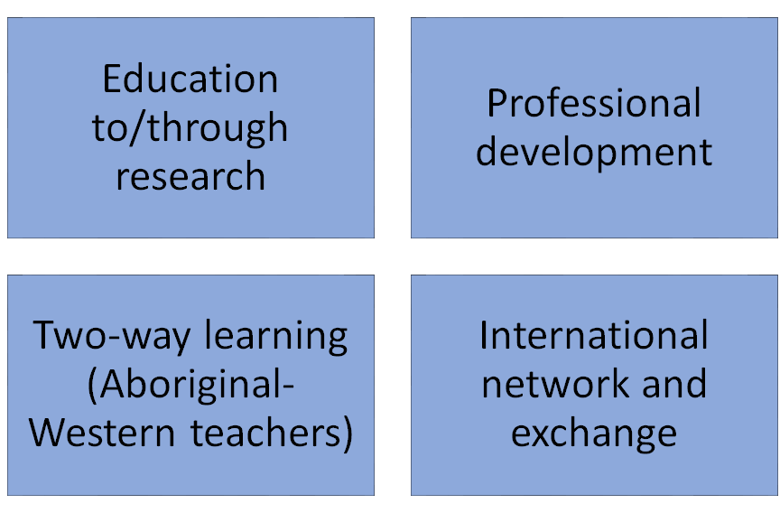
Synergies
Expanded circle of teachers
Core teachers
LINCDIRE Team
Notes:
Education to/through research (first level> developmental research)
Professional development (first and second level from team to educators)
two-way learning (cross-fertilisation)
International network and exchange (researchers, students, educators)
progress in expanding the circle

Slide 17
Lessons learned so far

Slide 18
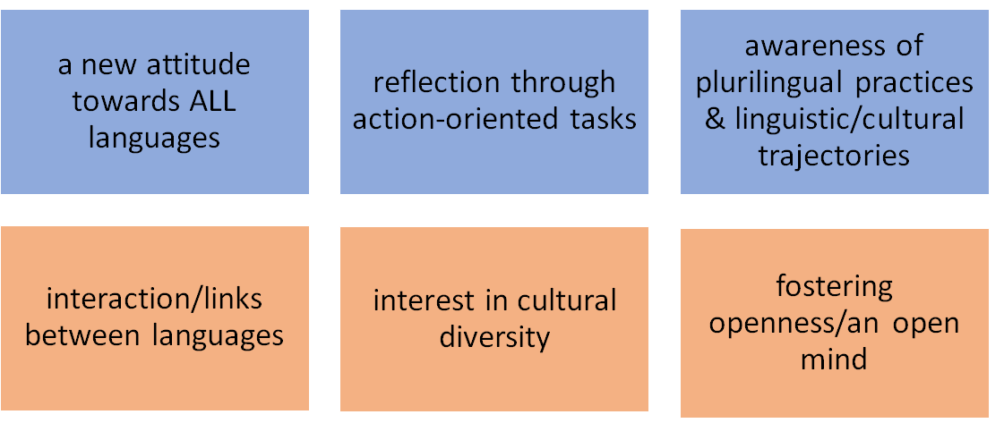
Paradigm shift Multilingualism Plurilingualism
Notes:
Le premier enjeux du projet du projet est de favoriser un changement de paradigme pédagogique qui permette de dépasser l’attitude monolingue (Gogolin, 1994) encore dominante surtout en Amérique du Nord en aidant les locuteurs résidant dans un pays multilingues à devenir des locuteurs plurilingues.
Developing:
A new attitude towards ALL languages (not only western languages but “less visible” languages of the communities -aboriginal heritage…)
Reflection through action-oriented tasks (as a way to integrate plurilingualism in real-life scenarios)
Awareness of plurilingual practices and linguistic/cultural trajectories (from the present to a life-long process)
Fostering:
Openness/open mind:
interaction and links between languages
interest in cultural diversity (curiosity and agency)

Slide 19
Perceptions of Educators & Researchers
Learning by doing: our progress as a team
Reaching out to the communities (teachers and learners) → cascading effect → teachers as professional developers/trainers
Fleshing out plurilingualism and action-oriented approach
Making the Medicine Wheel accessible to non-indigenous teachers
Making western (humanistic) views of learning accessible to indigenous teachers

Slide 20
Symposium Overview
Promoting plurilingualism in North America through a CEFR-inspired pedagogical online platform: LINCDIRE and LITE (Enrica Piccardo) The development of a pedagogical framework fusing Western and Indigenous approaches for plurilingual and pluricultural learning environments (Aline Germain-Rutherford & Alan Corbiere) Developing plurilingual, action-oriented tasks: Implications for pedagogy and teacher and student beliefs (Sara Potkonjak) Exploring the potential of technology to promote linguistic and cultural diversity: A plurilingual e-portfolio approach (Geoff Lawrence & Kris Johnston)
Opening remarks for discussion (Heather Lotherington)
Notes:
Linguistic and cultural diversity is inherent in North America, where both Canada and the U.S. are homes to multiple languages, including heritage, Aboriginal and official languages. This reality requires language teaching approaches that better reflect and enhance such diversity, and instill in teachers and learners a reenvisioned attitude towards language and cultural plurality (Cummins, 2007; Dyck & Kumar, 2012). This colloquium builds upon a large SSHRC-funded international research partnership which is developing a technology-enhanced, action-oriented approach that promotes plurilingualism (Piccardo, 2013) and examines its potential. With researchers and educators from Canadian, U.S., and French institutions, this project introduces a unique pedagogical model that includes plurilingualism and Indigenous pedagogies to actively draw on language learners’ existing “funds of knowledge” (Gonzalez, Moll & Amanti, 2006) in the development of strategic plurilingual competencies, fostering lifelong language and pluricultural learning. The first paper introduces the project’s scope and developmental stages, theoretical framework and contributing epistemologies, and the results of the piloting phrase. The second paper details the collaborative process of developing a unique pluricultural pedagogical framework that fuses Western and Indigenous approaches in education, embracing a “multiple cultures” model (Henderson, 1996; 2007) so minority languages and cultures are both considered and integrated in the learning environment (Germain-Rutherford, 2008). The third paper discusses the CEFR-inspired (Council of Europe, 2001) development of plurilingual/pluricultural action-oriented tasks and their pedagogical implications. The fourth paper presents the project’s online environment, including its medicine wheel informed e-portfolio tool and the LMS which integrates action-oriented, plurilingual tasks.

Slide 21
Socio-constructivist approach
(Vygotsky)
Developing a pedagogical framework:
WESTERN INFLUENCES
Multiple Cultures Model
(Henderson)
Humanist approach
(Rogers, Maslow)
Sociocultural
Theories
of
Learning
Plurilingual
approach
(Council of Europe - CoE)
Place / Community- based approach
(Sobel)
Action-
Oriented approach / TBA
(CoE
Nunan)
Notes:
Sociocultural Theories of Learning: Bandura’s Social Cognitive Theory (1986) and Vygotsky’s Social Development Theory (1978) in which social interaction is fundamental to cognitive development. All cognitive functions originate in, and are explained as products of social interactions. Learning is the process by which learners are integrated into a knowledge community. Learning is a collaborative process.
Humanism: a paradigm that emerged in the 1960s, focuses on the human freedom, dignity, and potential. A central assumption of humanism, is that people act with intentionality and values. Five basic objectives of the humanistic view of education: promote positive self-direction and independence (development of the regulatory system);develop the ability to take responsibility for what is learned (regulatory and affective systems); develop creativity (divergent thinking aspect of cognition); curiosity (exploratory behavior, a function of imbalance or dissonance in any of the systems); and an interest in the arts (primarily to develop the affective/emotional system).
Task-based approach aims at providing opportunities for learners to experiment with and explore both spoken and written language through learning activities which are designed to engage learners in the authentic, practical and functional use of language for meaningful purposes.
Multiple Cultures model: based on the consistent interaction of academic, dominant and minority cultures integrated into course design. In this model, epistemological and educational philosophy differences among the three cultures are thoroughly considered and integrated in the educational dimensions involved in the design of the teaching and learning environment
Community/Placed-based education: In the Western philosophy place/community-based education is linked to concepts such as civic education, contextual education, service learning, or even workplace education. It is seen as a way to strengthen the relation between formal learning, at school, and the reality of the community life. In the late 1890s, John Dewey spoke of the School's isolation from life: " When the child gets into the schoolroom he has to put out of his mind a large part of the ideas, interests, and activities that predominate in his home and neighborhood. So the school, being unable to utilize this everyday experience, sets painfully to work, on another tack and by a variety of means, to arouse in the child an interest in school studies." Dewey, 1959, pp.76-77)
Students need to engage in real-world, and engage in projects where they demonstrate their knowledge through creativity and collaboration.
In this approach learning is rooted in what is local - the unique history, environment, culture, economy, literature and art of a particular place. The community provides the context for learning, student work focuses on community needs and interests, and community members serve as resources and partners in every aspects of teaching and learning. This local focus has the power to engage students academically, pairing real-world relevance with intellectual rigor, while promoting genuine citizenship and preparing people to respect and live well in any community they choose.
Sobel provides in 2004 a more pragmatic definition that educators can easily translate into pedagogical actions: "Place-based education is the process of using the local community and environment as a starting point to teach concepts in language arts, mathematics, social studies, science, and other subjects across the curriculum. Emphasizing hands-on, real-world learning experiences, this approach to education increases academic achievement, helps students develop stronger ties to their community, enhances students' appreciation for the natural world, and creates a heightened commitment to serving ad active, contributing citizens." p.23
Plurilingualism: « Plurilingual education challenges monolingual attitudes and embraces all language learning, e.g. mother-tongue/s, language/s of schooling, foreign languages, regional and minority languages” (European Center for Modern Languages website, n.d.). From a plurilingual perspective, languages are not seen as coexisting in somebody’s mind as separate entities but as entwined and interrelated to form a composite competence, allowing students to develop more effective learning strategies using all the linguistic and cultural tools at their disposal (Coste, 2014; Coste, Moore & Zarate, 2009; Council of Europe, 2001). More importantly, students’ home languages and cultures are acknowledged and valued in the learning activities, essential to ease the integration of students coming from migrant families into schools and society (Boix-Mansilla & Jackson, 2011; Cummins, 2007).

Slide 22
Socio-constructivist approach
(Vygotsky)
Developing a pedagogical framework:
WESTERN INFLUENCES
Multiple Cultures Model
(Henderson)
Humanist approach
(Rogers, Maslow)
Sociocultural
Theories
of
Learning
Social interaction is fundamental to cognitive development. All cognitive functions originate in, and are explained as products of social interaction.
Plurilingual
approach
(Council of Europe - CoE)
Place / Community- based approach
(Sobel)
Action-
Oriented approach / TBA
(CoE
Nunan)

Slide 23
Socio-constructivist approach
(Vygotsky)
Developing a pedagogical framework:
WESTERN INFLUENCES
Multiple Cultures Model
(Henderson)
Humanist approach
(Rogers, Maslow)
Sociocultural
Theories
of
Learning
Humanism: a holistic approach focusing on the human freedom, dignity, and potential. A central assumption of humanism, is that people act with intentionality and values. It promotes positive self-direction and independence, the ability to take responsibility for what is learned, creativity and curiosity.
Plurilingual
approach
(Council of Europe - CoE)
Place / Community- based approach
(Sobel)
Action-
Oriented approach / TBA
(CoE
Nunan)

Slide 24
Socio-constructivist approach
(Vygotsky)
Developing a pedagogical framework:
WESTERN INFLUENCES
Multiple Cultures Model
(Henderson)
Humanist approach
(Rogers, Maslow)
Sociocultural
Theories
of
Learning
In a Community-based approach “learning is rooted in what is local - the unique history, environment, culture, economy, literature and art of a particular place. The community provides the context for learning, student work focuses on community needs and interests, and community members serve as resources and partners in every aspects of teaching and learning” (Sobel, 2010 p.23).
Plurilingual
approach
(Council of Europe - CoE)
Place / Community- based approach
(Sobel)
Action-
Oriented approach / TBA
(CoE
Nunan)

Slide 25
Socio-constructivist approach
(Vygotsky)
Developing a pedagogical framework:
WESTERN INFLUENCES
Multiple Cultures Model
(Henderson)
Humanist approach
(Rogers, Maslow)
Sociocultural
Theories
of
Learning
An Action-Oriented approach aims at providing opportunities for learners to experiment with and explore both spoken and written language through real-life scenarios designed to engage learners in the authentic, practical and functional use of language for meaningful purposes.
Plurilingual
approach
(Council of Europe - CoE)
Place / Community- based approach
(Sobel)
Action-
Oriented approach / TBA
(CoE
Nunan)

Slide 26
Socio-constructivist approach
(Vygotsky)
Developing a pedagogical framework:
WESTERN INFLUENCES
Multiple Cultures Model
(Henderson)
Humanist approach
(Rogers, Maslow)
Sociocultural
Theories
of
Learning
From a plurilingual perspective, languages are not seen as coexisting in somebody’s mind as separate entities but as entwined and interrelated to form a composite competence, allowing students to develop more effective learning strategies using all the linguistic and cultural tools at their disposal.
Plurilingual
approach
(Council of Europe - CoE)
Place / Community- based approach
(Sobel)
Action-
Oriented approach / TBA
(CoE
Nunan)

Slide 27
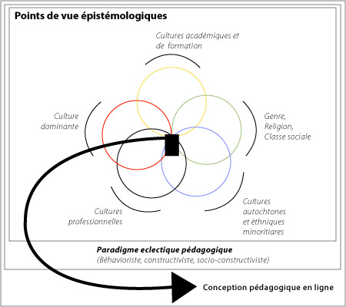
Multiple Cultures Model
(Henderson, 2007)
Standpoint Epistemologies, Henderson, 2007, p.136
Global Academic / Training / Entrepreneurial Cultures
« A multiple cultural model strives for a coherent interplay among three cultural logics: global academia or training cultures, the dominant culture and the minority cultures » (Henderson, 2008, p.136)
Dominant
Culture
Gender
Religion
Class
In this model learning materials and activities centred on epistemological pluralism help raise students’ awareness of cultural diversity and allow them to co-construct, in their interaction with their peers, a learning space where multiple cultural perspectives are made visible and debatable.
Indigenous & Ethnic Minorities
Cultures
Workplace
Cultures
Instructional Design
Notes:
Multiple cultures model: based on the consistent interaction of academic, dominant and minority cultures integrated into course design. In this model, epistemological and educational philosophy differences among the three cultures are thoroughly considered and integrated in the educational dimensions involved in the design of the teaching and learning environment

Slide 28
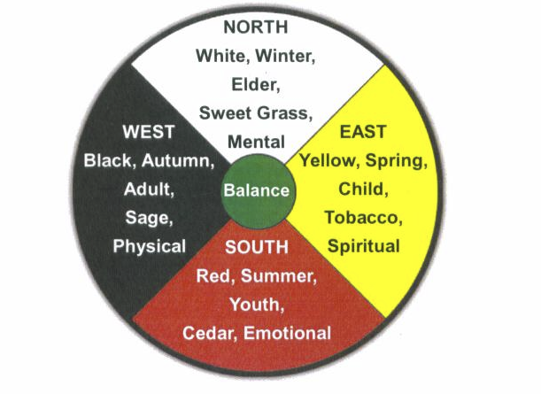
Developing a pedagogical framework: INDIGENOUS EPISTEMOLOGY
All things, material and spiritual, are interconnected and interdependent in a circular pattern of the cycles of nature”. (Leik, 2009, p.19)
“The framework of the Medicine Wheel is based on the sacredness of the number four. […] Movement in the Medicine Wheel is based in natural rhythms such as in moving through seasons, through life stages or through the cycle of day.” (LaFever, 2017, p. 173)
Dans la langue crie, le cercle d’influences s’appelle ‘pimatisiwin’, mot qui signifie “vie” (Education et Recherche Manitoba, 2003, p.9)
Notes:
The Medicine Wheel is a key symbol in Indigenous cultures. It is based on a circular pattern and cyclical set of four: the four seasons, the four stages of life, the four bio-psychosocial and spiritual aspects of a person. Dans la langue crie, le cercle d’influences s’appelle pimatisiwin, mot qui signifie “vie” (2003: p.9. Intégration des perspectives autochtones dans les programmes díÈtudes : ouvrage de référence pour les concepteurs de programmes d’études, les enseignants et les administrateurs, Education et Recherche Manitoba)
Tous les cercles d’influences ont des éléments en commun mais chacun est unique puisqu’il dépend des enseignements que la personne concernée a eus, de ses expériences personnelles et de la façon dont elle interprete l’interdépendance des aspects de la vie qu’elle représente à l’aide du cercle d’influences.
The Four Cardinal points on the Medicine Wheel are the Four Sacred Directions, represented among the Ojibwe by the colours yellow, red, black and white. At the center of the wheel is the spiritual essence of the self, balance, hamornie. (Pitawanakwat, 2006). Le cercle d’influences sert à représenter l’interdépendance des aspects de la vie et à donner à quelqu’un une orientation et un sens à sa vie.
Contrary to the Western perspective where knowledge is structured and organized in separate disciplines, in the Indigenous epistemology “All things, material and spiritual, are interconnected and interdependent in a circular pattern of the cycles of nature”. (Leik, 2009, p.19)

Slide 29
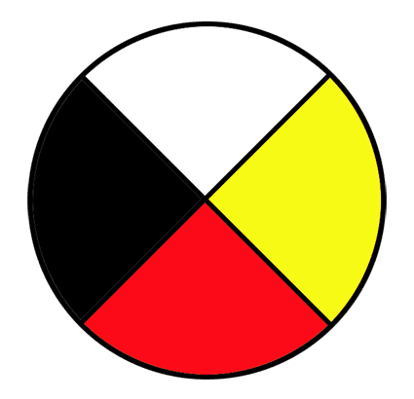
A Pedagogical Framework Fusing Indigenous and Western Epistemologies
Mind
Decisions
LINCDIRE’s pedagogical framework integrates a holistic and inclusive perspective to organize teaching and guide learning through each of the circle quadrants, whether in the instructional design of the learning tasks or in the LITE (Language Integration through E-portfolio) architecture that students will use.
The central part of the Medicine Wheel, to which all learning is convergent, is at the heart of the learner's identity and spiritual construction. (Pitawanakwat, 2006)
Hence, the learner is seen holistically as a thinking, verbal and non-verbal, emotional and spiritual human being rooted in the values of her/his plurilingual and pluricultural communities.
Focus on Metalinguistic and Metacognitive Awareness
Body
Actions
Spirit
Values
Focus on learning experiences & non-verbal strategies
Focus on my roots/community & intercultural growth
Emotions
Reactions
Focus on my story
Notes:
Our pedagogical framework fuses Western and Indigenous approaches. In an attempt to integrate the humanistic and holistic perspectives of Indigenous epistemology (Battiste, 2002; Yunkaporta, 2009, Child & Benwell, 2015) “where all things, material and spiritual, are interconnected and interdependent” (Leik, 2009, p.19), in a circular pattern of the cycles of nature, and the Western perspective which structures knowledge in separate disciplines, we propose a pedagogical framework based on the Aboriginal Life Cycle Wheel (Aboriginal Family Healing Joint Steering Committee, 1993) and the Medicine Wheel (Pitawanakwat, 2006). In this framework, the learner is seen holistically in different stages of maturity (childhood, adolescence and adulthood) as a thinking, verbal and non-verbal, emotional and spiritual human being rooted in the values of her/his plurilingual and pluricultural communities.
In the same way that the circle of influences guides our understanding and physical, temporal and spiritual experience of the world in which we live, the pedagogical approach proposed in the LINCDIRE project integrates a holistic and inclusive perspective to organize teaching and guide learning through each of the circle quadrants, whether in the instructional design of the learning tasks or the LITE (Language Integration through E-portfolio) architecture that students will use. The central part of the Medicine Wheel, to which all learning is convergent, is at the heart of the learner's identity and spiritual construction (Pitawanakwat, 2006) and is translated into the electronic portfolio by a space where learners conserve and archive Projects and works that illustrate the development of their plurilingual and pluricultural individuality.

Slide 30
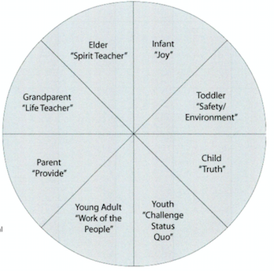
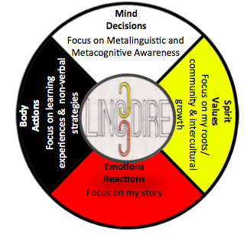
In this holistic perspective the learner is seen at different stages of maturity (childhood, adolescence and adulthood). The central part of the Medicine Wheel is translated into the electronic portfolio by a space where learners conserve and archive projects and works that illustrate the development of their plurilingual and pluricultural individuality.
Notes:
Dans notre systme d’éducation, le savoir se gagne. On apprend à écouter, comme un être humain qui a le don d’entendre ce qui se dit. On ne met pas le savoir dans la tête ni dans les mains de l’apprenant. On donne des conseils mais pas de réponses. On ne fait pas croire aux gens que les réponses viennent de l’extérieur. Les réponses viennent de l’intérieur. (Wes Fineday, publication du Protocole de l’Ouest canadien 7) (Trad. libre)

Slide 31
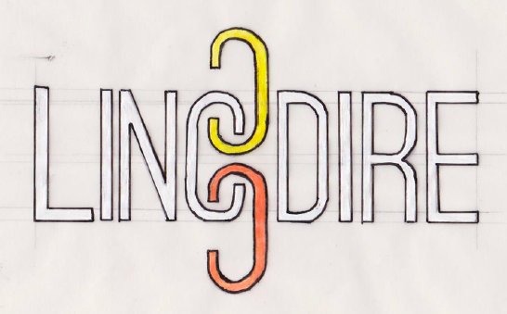
student e-portfolio: possible lines of questioning at the level of each scenario/task
Self-Reflection on:
my language learning
plurilingual awareness and skills
my learning strategies
My Chosen Work
Mind
Decisions
Focus on Metalinguistic and Metacognitive Awareness
Self-Reflection on my roots and inter-/cross-cultural encounters
Body
Actions
Spirit
Values
Focus on learning experiences & non-verbal strategies
Focus on my roots/community & intercultural growth
Self-Reflection on My Learning Experiences
Emotions
Reactions
Focus on my story
Self-Reflection on self as plurilingual being

Slide 32
Symposium Overview
Promoting plurilingualism in North America through a CEFR-inspired pedagogical online platform: LINCDIRE and LITE (Enrica Piccardo) The development of a pedagogical framework fusing Western and Indigenous approaches for plurilingual and pluricultural learning environments (Aline Germain-Rutherford & Alan Corbiere) Developing plurilingual, action-oriented tasks: Implications for pedagogy and teacher and student beliefs (Sara Potkonjak) Exploring the potential of technology to promote linguistic and cultural diversity: A plurilingual e-portfolio approach (Geoff Lawrence & Kris Johnston)
Opening remarks for discussion (Heather Lotherington)
Notes:
Linguistic and cultural diversity is inherent in North America, where both Canada and the U.S. are homes to multiple languages, including heritage, Aboriginal and official languages. This reality requires language teaching approaches that better reflect and enhance such diversity, and instill in teachers and learners a reenvisioned attitude towards language and cultural plurality (Cummins, 2007; Dyck & Kumar, 2012). This colloquium builds upon a large SSHRC-funded international research partnership which is developing a technology-enhanced, action-oriented approach that promotes plurilingualism (Piccardo, 2013) and examines its potential. With researchers and educators from Canadian, U.S., and French institutions, this project introduces a unique pedagogical model that includes plurilingualism and Indigenous pedagogies to actively draw on language learners’ existing “funds of knowledge” (Gonzalez, Moll & Amanti, 2006) in the development of strategic plurilingual competencies, fostering lifelong language and pluricultural learning. The first paper introduces the project’s scope and developmental stages, theoretical framework and contributing epistemologies, and the results of the piloting phrase. The second paper details the collaborative process of developing a unique pluricultural pedagogical framework that fuses Western and Indigenous approaches in education, embracing a “multiple cultures” model (Henderson, 1996; 2007) so minority languages and cultures are both considered and integrated in the learning environment (Germain-Rutherford, 2008). The third paper discusses the CEFR-inspired (Council of Europe, 2001) development of plurilingual/pluricultural action-oriented tasks and their pedagogical implications. The fourth paper presents the project’s online environment, including its medicine wheel informed e-portfolio tool and the LMS which integrates action-oriented, plurilingual tasks.

Slide 33
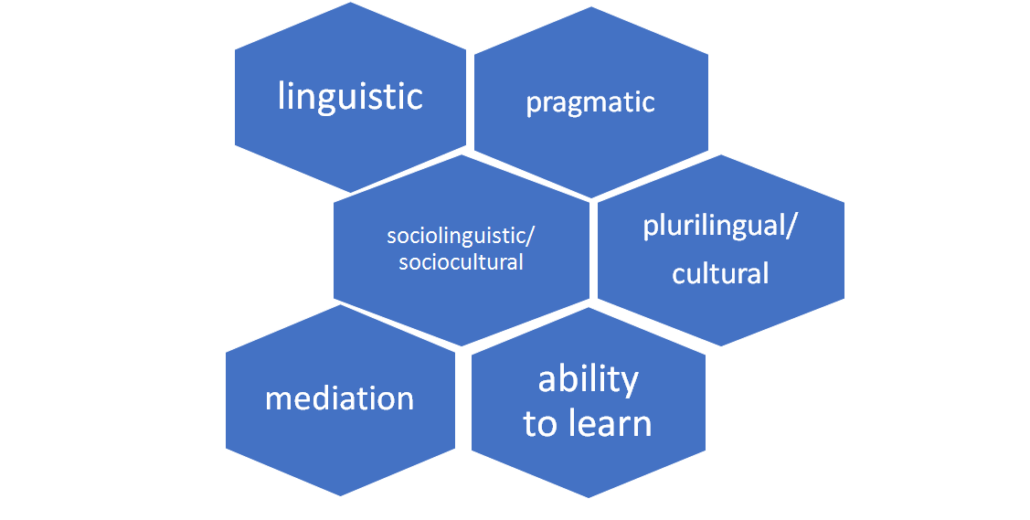
LINCDIRE pedagogical model

Slide 34
LINCDIRE pedagogical model
students’ work is organized around a series of real-life action-oriented tasks
activities within each task speak to the medicine-wheel quadrants
students’ existing language resources are encouraged in the task
collaborative work among students of different languages/cultures
reflective learning encouraged through post-task reflection

Slide 35
Using the LINCDIRE template to design tasks
Part 1: Task description
Part 2: My task planner
Part 3: Task development
Part 4: Observation checklist
Part 5: Self-assessment checklist
Notes:
Part 1: Overview of the task; uses a backwards design; where teachers design a scenario based on the comm. activities & competences they wish to draw on and develop; and outline the ways this task might speak to the different quadrants of the MW & contribute to the holistic development of the learner.
Part 3 is the step-by-step task development where the different subtasks are outlined in detail
Part 2 provides an overview of the task to make sure that all the elements outlined in Part 1 are actually involved in the subtasks. And from my own experience using the template, I found that I wasn’t really engaging with the medicine wheel quadrants.
Part 4 and Part 5: checklists for the teacher and a checklist & reflection for the student which Geoff & Kris will speak to in a moment .

Slide 36
Training material: Online Tutorials
Notes:
We decided to create a series of YouTube tutorials for our participating teachers; these outline plurilingualism, the action-oriented approach, the medicine wheel, as well as providing a step-by-step guide to use of the template.

Slide 37
Task Scenario: 21st century storytelling
To encourage younger community members to actively appreciate stories, your local library is asking the community to donate their favourite childhood fairytales . You take a look through your collection and decide that these need to be updated because they are not written in German and do not include any modern morals that can speak to the younger generation.
To complete this task, you will need to write an original German fairy-tale with modern twists for a 21st century child.
Target learners (CEFR level/grade): A2/B1 high-school/adult students
Other languages involved: students’ home languages and cultures, English, elements of indigenous and other languages

Slide 38
Students compare storytelling conventions in different languages/cultures they know.
The class “publishes” an anthology and displays this anthology in the (school or community) library.
Mind
Decisions
Focus on Metalinguistic and Metacognitive Awareness
Spirit
Values
Body
Actions
Focus on my roots/community & intercultural growth
Focus on learning experiences & non-verbal strategies
Emotions
Reactions
Students focus on the nonverbal aspects of storytelling.
Focus on my story
Students bring in their favourite childhood fairytales, and read these to other students.
Notes:
The anthology can be shared with children who understand the target language, and/or subsequent classes of students taking this course.
and then use their prior knowledge of linguistic and narrative clues to arrange pieces of a scrambled German fairytale in a logical order
, including appropriate volume, pace, intonation, sound effects, different voices for different characters’ dialogue, facial expressions, props and gestures/movements in the telling of a story.
regardless of the language they are in. Other students focus on trying to understand the story using knowledge from other languages they speak, visual and contextual clues.

Slide 39
Examples of student creative works: 21st century student morals
A lonely goat sets off to find other goats and wants to share a beautiful greeting with them, but they don't understand her when she speaks. Moral: Be yourself because there will always be a friend for everyone. -Veronica
An irritable king banishes all the farmers in his kingdom to a horrible wasteland called Canada. Eventually he sees the error in his decision and comes to beg them to return. Moral: Don't alienate people. - Ryan
A princess is expected to marry a prince from the the neighbouring kingdom, but she prefers his sister instead. After some hesitation her parents agree that she should marry the one who will truly make her happy. Moral: Gay is OK. -Saskia

Slide 40
Task Scenario: The fall feast
Every year, there is a Fall Feast to feed the spirits. This year, you have been asked to work as a guide during the feast. You will prepare an invitation for your parents and grandparents, and then guide your family through the feast, teaching them about each type of food, how it was cooked, and its importance to the feast.
Target learners (CEFR level/grade): A2 learners/ kindergarten, Grades 1, 2, 3
Main target language: Ojibway
Other languages involved: English
Notes:
(an example of a task developed for Alan’s context… but also we are aware of the need for ojibway tasks which move beyond traditional understandings of culture)

Slide 41
Students reconstruct the history of the feast using visual clues.
During the feast students are guides and language ambassadors, so parents can learn some words about the feast from the children.
Mind
Decisions
Focus on Metalinguistic and Metacognitive Awareness
Spirit
Values
Body
Actions
Focus on my roots/community & intercultural growth
Focus on learning experiences & non-verbal strategies
Students use their bodies to express how they feel about a particular food item.
Emotions
Reactions
Focus on my story
Invite students to draw a picture of their facial expression to show their level of excitement.
Notes:
...to encourage their children to speak in Ojibway as much as possible
Discuss what you like most about the feast and encourage students to think about what they are most excited about.
Introduce a matching activity with pictures and fall feast items so that … Students take turns picking up cards from the floor and trying to complete the missing points from the timeline
classroom according to how they feel about the particular food item. One wall of the classroom can represent “I love it” and the opposite wall, “I hate it”. Ask students to position themselves on an ideal line following the prompt.

Slide 42
Piloting phase (Fall 2017-Winter 2018)
Online discussions with teachers
Classroom observations
Teacher interviews
Online student survey
Student focus groups
LITE learner analytics
Tasks
Tool
Resources
Methodology
Pluri-dimension
Pre-piloting phase
(Winter / Spring 2017)
Notes:
With our core teachers, we have currently moved out of our pre-piloting phase. The pre-piloting phase entailed familiarizing our core teachers with the project
- collaboratively analyzing and envisioning the use of tasks in their local teaching contexts (important that teachers selected the tasks they wished to use/thought was appropriate for their context and thinking about how it needs to be adapted. Also received some feedback on their past challenges and successes using action-oriented approaches (as was the case with Aline’s colleague) and used that information to help us design tutorials
- obtaining informal, unstructured feedback on our training materials, template, and tasks as we continue to prepare these for piloting (it is this feedback that will be reported on in this portion of the presentation). And what’s been great so far is that the teachers we did select have shown a great interest in the project and have made efforts to join our meetings, to share their concerns with us… they’ve been developing their materials to fit different contexts.
During the formal piloting phase, there will be 6 means of data collection:
Each of these methods is designed to obtain teacher and student feedback on:

Slide 43
Preliminary findings:
Training materials
overall positive feedback
some difficulty with Medicine Wheel (“Spirit” quadrant)
plurilingual pedagogy remains abstract
additional training materials for teachers of young learners

Slide 44
Preliminary findings: Task template
Advantage of various task template sections (linked to experience and familiarity with action-oriented approaches?)
CEFR terminology can be overwhelming & abstract (“CAN DO - but how?”)
Desire for more examples, scaffolding of some aspects of the tasks

Slide 45
Preliminary findings: discussions with core teachers & classroom observations
teacher-modeled examples/initial sharing encouraged students to investigate their own linguistic/cultural background
the need to address cultural assumptions of student autonomy/reflective approaches embedded in tasks/pedagogy
students expressed how the tasks confirmed their “real life” language use
openness to other languages throughout the process, but hesitance in the final task/product?
Notes:
(e.g. lost in a new town --- stopping someone for directions, you may use a combination of French/English)
(Something for us to consider as well - inserting a ‘plurilingual’ element into the final task)

Slide 46
Preliminary findings: LITE feasibility
emerging tension between the adaptability and usability of the tasks
adapting LITE for young learners and aboriginal language classrooms
scaffolding needed to clarify a plurilingual approach, the CEFR, and LINCDIRE’s pedagogical framework
mentoring teachers will play an important role
more input needed from Aboriginal language teachers

Slide 47
Symposium Overview
Promoting plurilingualism in North America through a CEFR-inspired pedagogical online platform: LINCDIRE and LITE (Enrica Piccardo) The development of a pedagogical framework fusing Western and Indigenous approaches for plurilingual and pluricultural learning environments (Aline Germain-Rutherford & Alan Corbiere) Developing plurilingual, action-oriented tasks: Implications for pedagogy and teacher and student beliefs (Sara Potkonjak) Exploring the potential of technology to promote linguistic and cultural diversity: A plurilingual e-portfolio approach (Geoff Lawrence & Kris Johnston)
Opening remarks for discussion (Heather Lotherington)
Notes:
Linguistic and cultural diversity is inherent in North America, where both Canada and the U.S. are homes to multiple languages, including heritage, Aboriginal and official languages. This reality requires language teaching approaches that better reflect and enhance such diversity, and instill in teachers and learners a reenvisioned attitude towards language and cultural plurality (Cummins, 2007; Dyck & Kumar, 2012). This colloquium builds upon a large SSHRC-funded international research partnership which is developing a technology-enhanced, action-oriented approach that promotes plurilingualism (Piccardo, 2013) and examines its potential. With researchers and educators from Canadian, U.S., and French institutions, this project introduces a unique pedagogical model that includes plurilingualism and Indigenous pedagogies to actively draw on language learners’ existing “funds of knowledge” (Gonzalez, Moll & Amanti, 2006) in the development of strategic plurilingual competencies, fostering lifelong language and pluricultural learning. The first paper introduces the project’s scope and developmental stages, theoretical framework and contributing epistemologies, and the results of the piloting phrase. The second paper details the collaborative process of developing a unique pluricultural pedagogical framework that fuses Western and Indigenous approaches in education, embracing a “multiple cultures” model (Henderson, 1996; 2007) so minority languages and cultures are both considered and integrated in the learning environment (Germain-Rutherford, 2008). The third paper discusses the CEFR-inspired (Council of Europe, 2001) development of plurilingual/pluricultural action-oriented tasks and their pedagogical implications. The fourth paper presents the project’s online environment, including its medicine wheel informed e-portfolio tool and the LMS which integrates action-oriented, plurilingual tasks.

Slide 48
Collaborative use of technology: language revitalization/plurilingual learning
Linguistic diversity and emerging forms of linguistic and cultural expression thrive in our increasingly digital world (Ortega, 2017).
Internet communication technologies (ICTs) used in L2 teaching/learning offer affordances that:
encourage experimentation - and play! - with multimodal forms of language-and-culture (Skyes, Oskoz & Thorne, 2016)
can facilitate pluricultural, meta-cognitive awareness and autonomy (Diehl & Prins, 2008)
can leverage imagination/imagery and emotion to play with & negotiate identity and visions of one’s ideal L2 selves (Dörnyei, 2009; Norton, 2013)
can create community, resources and learning environments to foster language revitalization (Eisenlohr, 2004)

Slide 49
LITE: Interconnected, but distinct areas
My Plurilingual Journey
To encourage identity negotiation, plurilingual/pluricultural awareness & learning
My tasks
To focus students on tasks completed and in progress
Medicine Wheel guided reflections
To build metacognitive skills/awareness, sense of self
Radar charts
User analytics to update students on linguistic, plurilingual progress in LITE

Slide 50
Gap in relevant online plurilingual tools
Difficulties
Existing software designed for e-portfolios required huge amounts of further development, especially concerning the user interface
Most of components have to be developed by ourselves
Not necessarily designed for plurilingual purposes; therefore,
Solutions
Made the decision to create our own plurilingual portfolio platform that supports the LINCDIRE pedagogical framework and project goals
Better to design from scratch

Slide 51
Unique Features of LITE
My Plurilingual Journey
My Tasks
Medicine Wheel Reflections
Radar Chart (Future Development)

Slide 52
My Plurilingual Journey

Slide 53
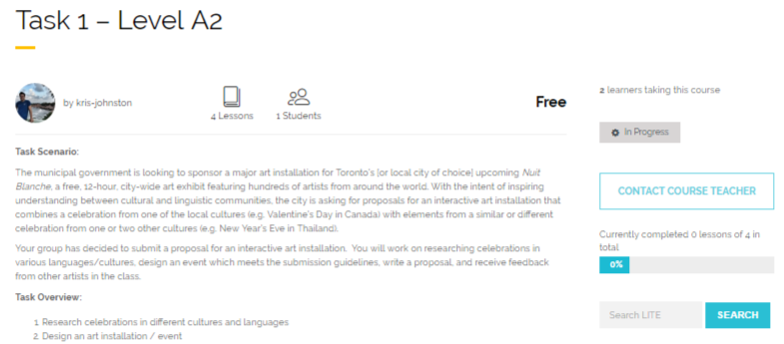
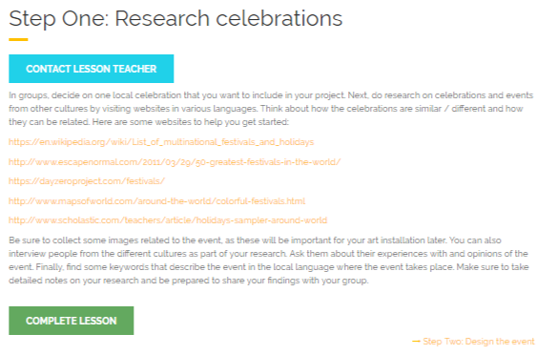
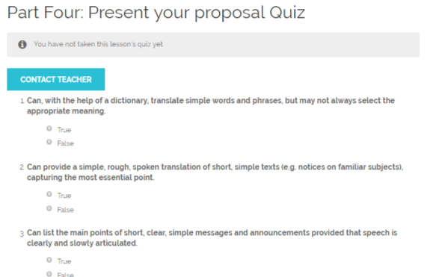
My Tasks
Tasks (Online or In-Class)
Immediately after each task, students will complete a short ‘Can Do’ quiz, based on Can Do statements from the CEFR
Then travel to the Do a Reflections Page to complete a reflection
Students may also choose to post the work they completed for a task and share
there is an option to also highlight this work in the ‘My Best Work’ page

Slide 54
Medicine Wheel Reflections
I’ve learned something from this task that I would like to share with others.
Sharing stories and experiences helped me and my classmates learn more about the topic.

Slide 55
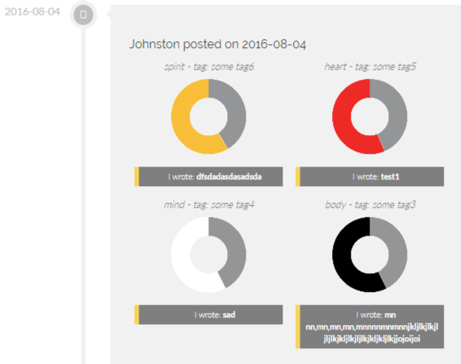
My Reflections
Each reflection creates a snapshot which is dated
This snapshot allows learners to reflect on their posts and see growth
The radar charts act as confidence guages and present an average of their scores

Slide 56
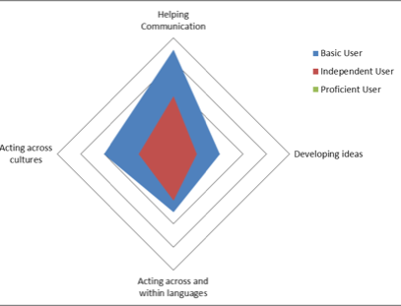
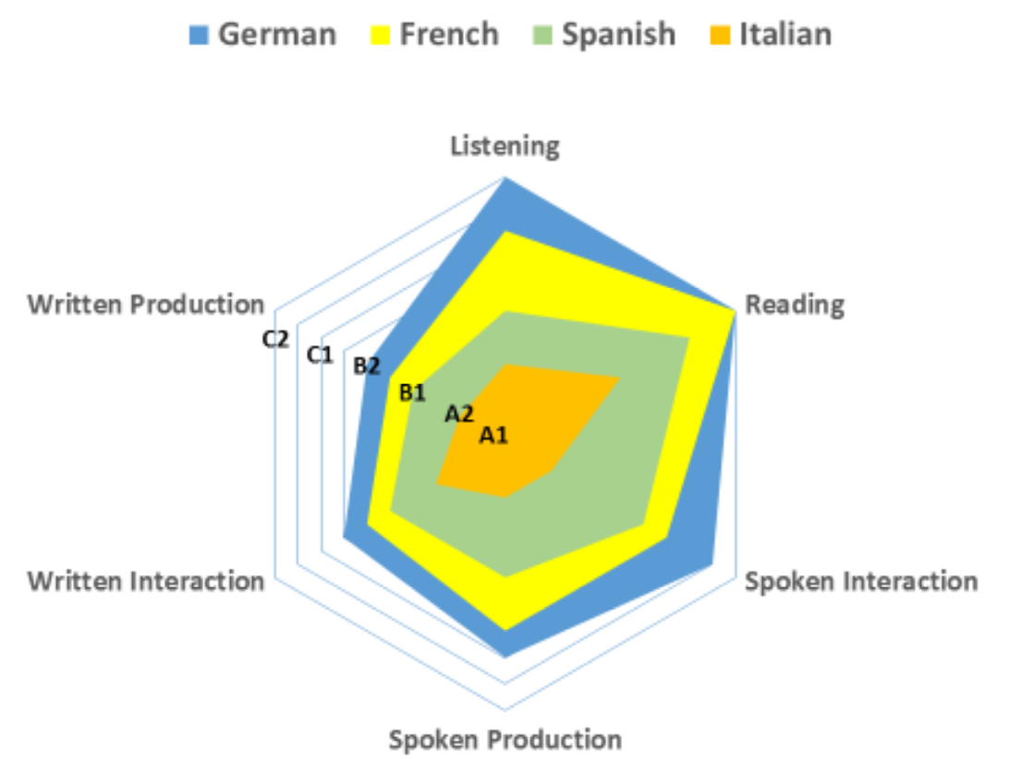
Radar Charts (Under Development)
Chart A
Chart B
Notes:
Radar charts - similar to these - are under development
They will explicitly illustrate individual student progress in linguistic, plurilingual and related areas in the project - based on learner-generated analytics
For example - chart A - sample showing tracking of mediational competencies (helping communication/developing ideas) and plurilingual (acting across/within languages) and plurilcultural competencies (acting across cultures)
Colour legend (top right corner) - reflects CEFR macro levels - i.e., basic user = A1/A2 of CEFR; independent user = B1/B2; proficient user = C1/C2 - a student’s progress will appear in a coloured image within these areas; the student’s image will change/grow as she/he progresses through the activities/reflections and self-assesses using the Can Do statements
This will provide a snapshot of student progress in selected learning areas - quantifying progress, motivating and validating learning
Chart B: example of a radar chart focusing on communicative skill areas in multiple languages
We’re still conceptualizing how these tools will look in the project but will integrate such a tool so the student and teacher can get an ongoing view of student progress

Slide 57
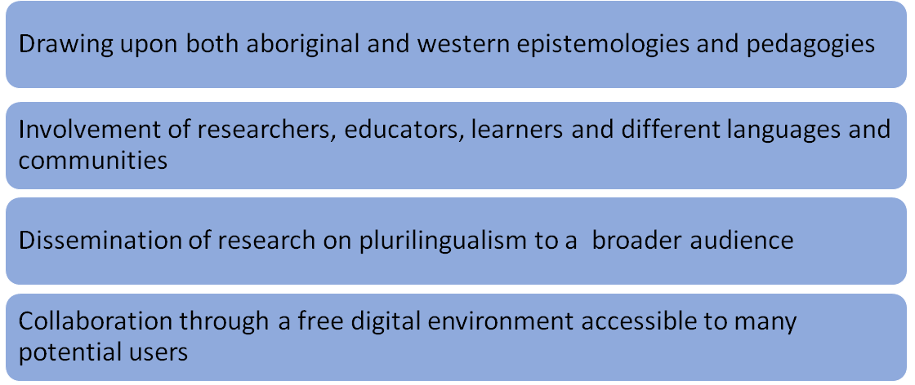
Implications

Slide 58
Conclusion
Making the Medicine Wheel and aboriginal epistemology accessible to non-indigenous teachers
Making latest non-indigenous conceptualization of language education accessible to indigenous teachers

Slide 59
Project Members
PI: Enrica Piccardo ( OISE – University of Toronto & Université Grenoble-Alpes)
Co-Applicants: Aline Germain-Rutherford (University of Ottawa) & Geoff Lawrence (York University)
Alan Corbiere (M’Chigeeng First Nation - Aboriginal Languages and Cultures, Canada)
Anette Guse (University of New Brunswick)
Alana Johns (University of Toronto,)
Coralie Payre-Ficout (Université Grenoble-Alpes, France)
Norman Sieweke (Edmonton Public Schools - Institute for Innovation in Second Language Education)
Nicola Townend (University of Toronto Schools)
Mary Ann Corbiere (University of Sudbury)
Research Assistants
Kimberly Cho (OISE-UofT)
Angelica Galante (OISE-UofT)
Kris Johnston (York)
Mama Ni Owoo (OISE-UofT)
Yecid Ortega (OISE-UofT)
Sara Potkonjak (York)
Michael Koslowski (York)
Merci! Miigwetch! Danke! Grazie! Thank you!

Slide 60
Opening the discussion
Discussant:
Heather Lotherington
York University

